Slide 1
Amazon S3 &Glacier
Abilash s r

Slide 2
What is S3 ?
S3 is safe place to store your files
Amazon S3 is the largest and most performant, secure, and feature-rich object storage service. S3 is designed for 99.999999999%(11 9's) durability to protect data from site-level failures, errors, and threats and stores data across a minimum of 3 availability zones.
S3 is recommended for storing static content such as graphic files, images, documents, audio, video and log files.
File can be 0-5TB as single object ! Guess about Storage Server ?

Slide 3
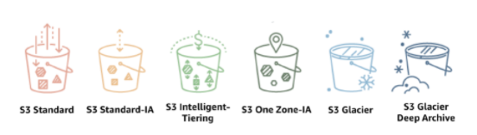
..
S3 can create inside the region
Bucket is a logical unit in s3 that is just like a folder and Objects is a file.
Bucket name is globally unique
Types of S3

Slide 4
Bucket Versioning and Tags
You can version your files in AWS S3.
It is enabled at the bucket level.
Same key overwrite will increment the Version 12 3
Protect against unintended deletes(Ability to restore a version)
Easy roll back to previous version
A tag is a label

Slide 5
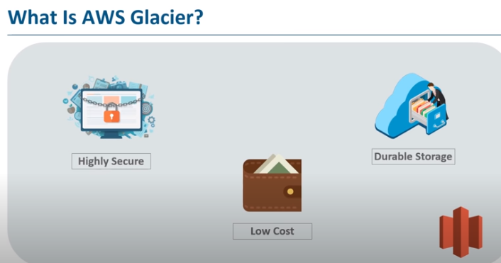

Slide 6
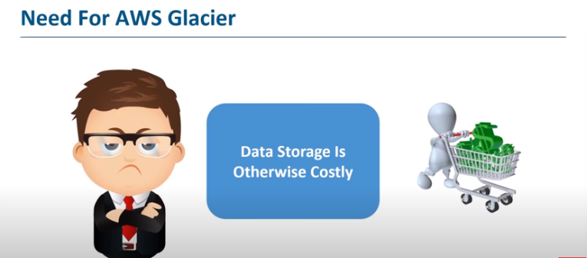

Slide 7
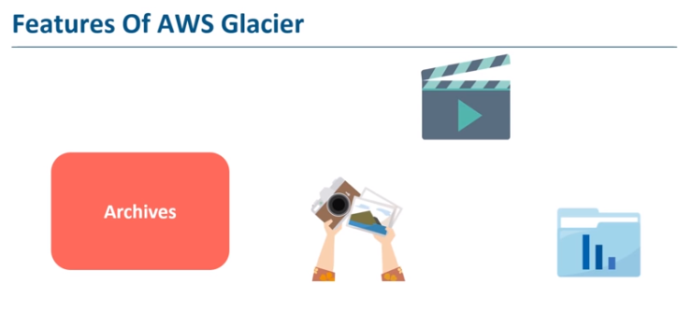

Slide 8
Benifits
10 times cheaper compare with S3
Single archive file will be 40TB
Fast Glacier Tool used for upload and download file
Lifecycle Rule
Glacier Retrieval options
Expedited Retrieval 1-5min
Standard Retrieval 3-5 hrs
Bulk Retrieval 5-12 hrs

